Slide 1
Spectral-Spatial Weak Signal Classification Using Deep Learning Techniques
# Team- 24,
Team Members
Harshvardhan - EE24RESCH04003
Abhilash - EE24RESCH11004
Pankaj - EE24MTECH12012
Adil - CS20BTECH11031
Under the guidance of:
Dr. Sumohana S Channappayya
Department of Electrical Engineering, IIT Hyderabad

Slide 2
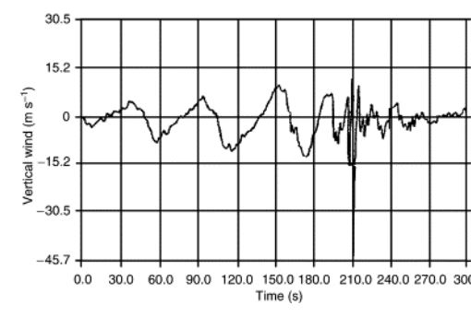
Introduction (1 / 2)
Radar (Radio Detection and Ranging) in aircraft:
Used in Navigation, weather monitoring, air traffic control, and collision avoidance.
Designed to detect non-precipitating clouds (clouds without significant water droplets or ice particles).
Clear Air Turbulence (CAT) :
It consists of sudden swirls of air that can occur around aircraft flying at high speeds, often going unnoticed by weather radar systems.
CAT arises from interactions between air masses with different velocities, pressures, or temperatures, particularly near irregular terrains or above cumulonimbus clouds.
Unpredictable nature and difficulty in detection by conventional weather radar systems
Fig:1 Starting from left at mountain,
smooth normal velocity to random jerk

Slide 3
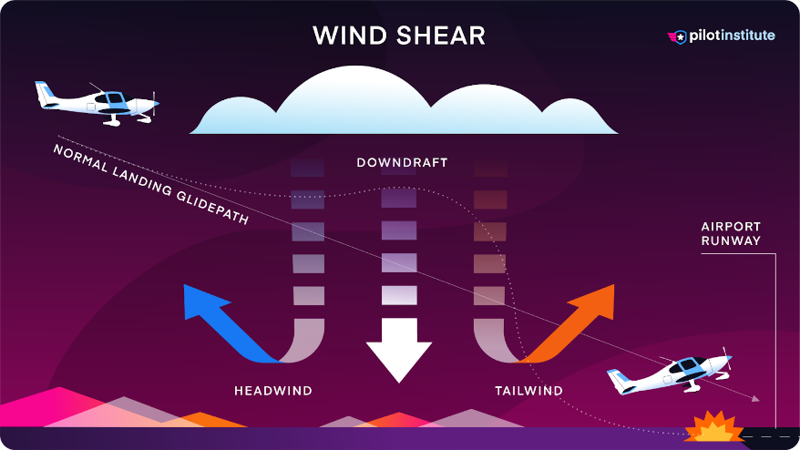
Introduction (2 / 2)
Impact of CAT
Lacks visual clues to warn pilots, making it difficult to detect.
CAT can directly cause aircraft accidents and indirectly interfere with radar echoes, impacting the quality of weather radar data.
In rare cases, severe or extreme turbulence can lead to loss of flight control or structural failures in aircraft.
Flight SQ321 experienced CAT while cruising at 37,000 feet, illustrating the potential dangers of this phenomenon.

Slide 4

Motivation
Need for Detection of CAT
Detection Challenges: Identifying the Low SNR target such as CAT is crucial for enhancing radar detection capabilities, as predicting its occurrence, severity, and intensity is challenging.
Safety Concerns: Due to the difficulties in detection, pilots often remain unaware of CAT scenarios, increasing safety risks.
Impact on Radar Data Quality
Pilot Awareness
Technological Advancement

Slide 5
Problem Statement
Clear Air Turbulence (CAT) occurs in clear skies, typically near the jet stream, mountain waves, or wind shear regions. Predicting CAT is challenging due to the lack of direct visual indicators. CAT prediction involves identifying areas of high turbulence probability based on atmospheric parameters.
Key Atmospheric Parameters:
1. Vertical Wind Shear (S): Rate of change of wind speed with height.
2. Deformation (D): Measures of flow stretching or compression
3. Richardson Number (Ri): A dimensionless number that indicates stability.
4. Eddy Dissipation Rate (ϵ): A direct measure of turbulence intensity.
5. Temperature Gradient (∇T): Affects stability and turbulence formation

Slide 6
Literature Review
The Federal Aviation Administration [1] defines CAT as “sudden severe turbulence occurring in cloudless regions that causes violent buffeting of aircraft.
In [2], it was shown, that CAT SNR lesser than 10 dB is captured more effectively through Reduced-Rank Multistage Wiener Filter(RR-MWF) in comparison to the conventional weather radar signal processing method which is Pulse Pair Processing (PPP).
FDA. Fedaral aviation administartion. https:// www.independent.co.uk/travel/news- and- advice/turbulence-singapore-airlines-flight-what-causes-b2572488.html. 1, accessed 22.09.2024
Renbiao Wu, Yuandan Fan, Xiaoguang Lu, Zhe Zhang, and Hai Li. Detection of clear air turbulence by airborne weather radar using rr-mwf method. In 2018 IEEE/AIAA 37th Digital Avionics Systems Conference (DASC), pages 1–5, 2018. 1

Slide 7
Literature Review
In [3], the work proposes a Dynamic Matrix Completion (DMC)-based approach which is an optimization technique for use in the front-end of MIMO radar. The proposed approach suggests a Dynamic Singular Value thresholding technique which helps in eliminating the noise returns early in the processing chain.
The result shown was in terms of enhanced probability of detection, reduced false alarm rate, and ultimately, improved target tracking performance.
In [4], the author employs a neural network technique i.e, Faster Region based Convolutional neural network (R-CNN) for object detection in densely populated areas, noting that SNR limitations were not a concern. The study also highlights that the performance of the Single Shot Detector (SSD) surpasses that of the YOLOv5 model. However, the SSD may struggle to identify small objects in complex scenarios or when multiple sensors are integrated.
Harsha Vardhan, Ruchi Tripathi, and Ketan Rajawat. Adaptive front-end for mimo radar with dynamic matrix completion. In 2020 International Conference on Signal Processing and Communications (SPCOM), pages 1–5, 2020. 1
Reagan L. Galvez, Argel A. Bandala, Elmer P. Dadios, Ryan Rhay P. Vicerra, and Jose Martin Z. Maningo. Object detection using convolutional neural networks. In TENCON 2018 - 2018 IEEE Region 10 conference, pages 2023–2027, 2018. 1

Slide 8
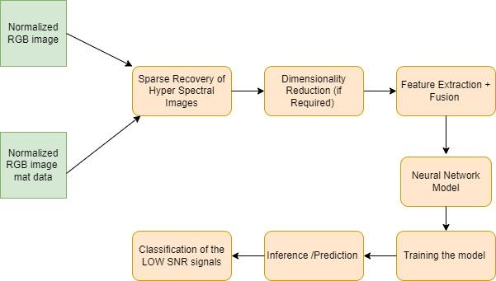
Implementation
:v
Multiple.mat files with associated RGB images are collected.
RGB images and HSI data normalization, as well as dimensionality reduction if data sets include redundant information.
Using the neural network (NN) technique, extract spatial features from RGB images and spectral features from HSI data. To generate a complete feature set, combine the extracted spatial and spectral information
Develop the neural network model and use fused spectral-spatial features to train it.
We can use a new data set to test and refine the model once it has been trained. Classifying the various signal kinds in the HSI images is the task of the trained model
Figure 2: Signal flow diagram
Users/adilsalfi/Desktop/Deeplearning_Project_V2_secondsubmission.pdf

Slide 9
Implementation (Contd:)
Data Collection and Loading Multiple.mat files with associated RGB images is collected. RGB images are in a 3D array format (e.g., 32x32x3) and the HSI data is in a 3D array format (e.g., 32x32x3)
Data Preprocessing: RGB images and HSI data normalization, as well as dimensionality reduction if data sets include redundant information.
To improve the effectiveness of classification, we converted RGB weather and clutter images to HSI, as HSI color space provides enhanced color discrimination, simplifies color detection, and offers robustness against illumination changes, ultimately leading to improved classification accuracy.
The set of images consisting of weather only, weather with clutter are obtained from the .mat files which consists of I-Q samples from radar. We then labeled the available images manually using the image label package. The main classification labels are weather and clutter. Then we trained the YOLOV5s model, which uses R- CNN as backbone for classification tasks. For training, the 70% of available labeled images were used and remaining for testing.
We can use a new data set to test and refine the model once it has been trained. Classifying the various signal kinds in the HSI images is the task of the trained model
The geometric Approach used for converting RGB to HSI ( Hue, Saturation, Intensity) and vice-versa is mentioned in the below link.

Slide 10
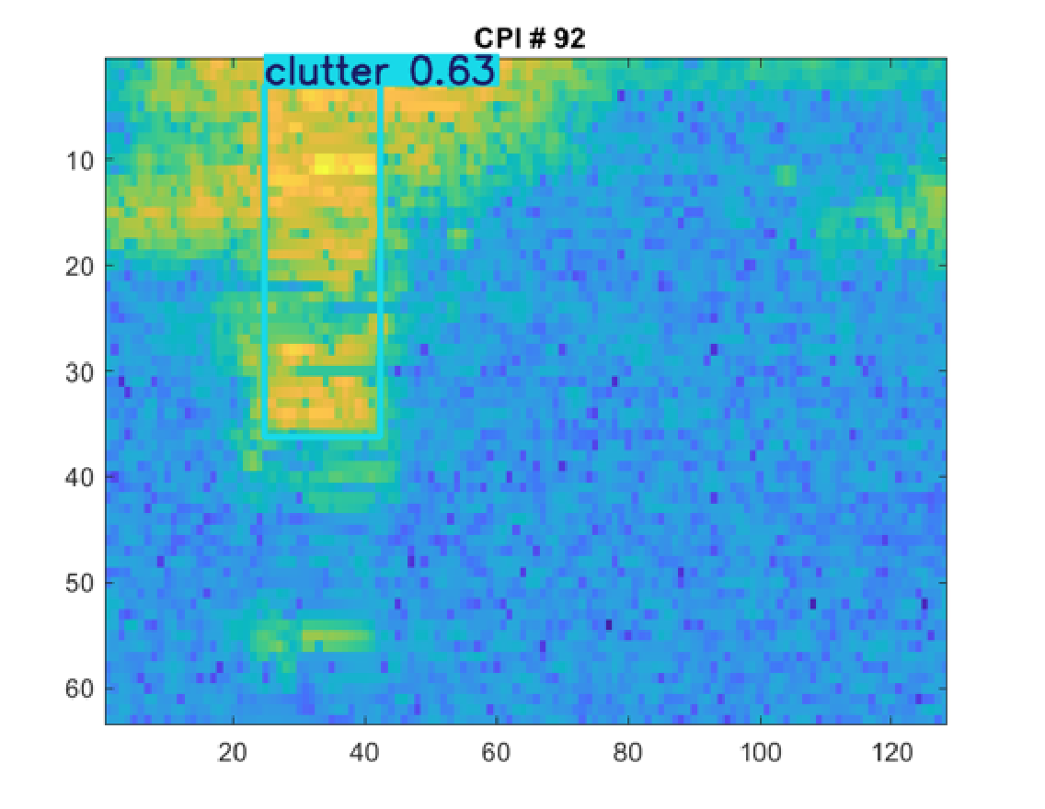
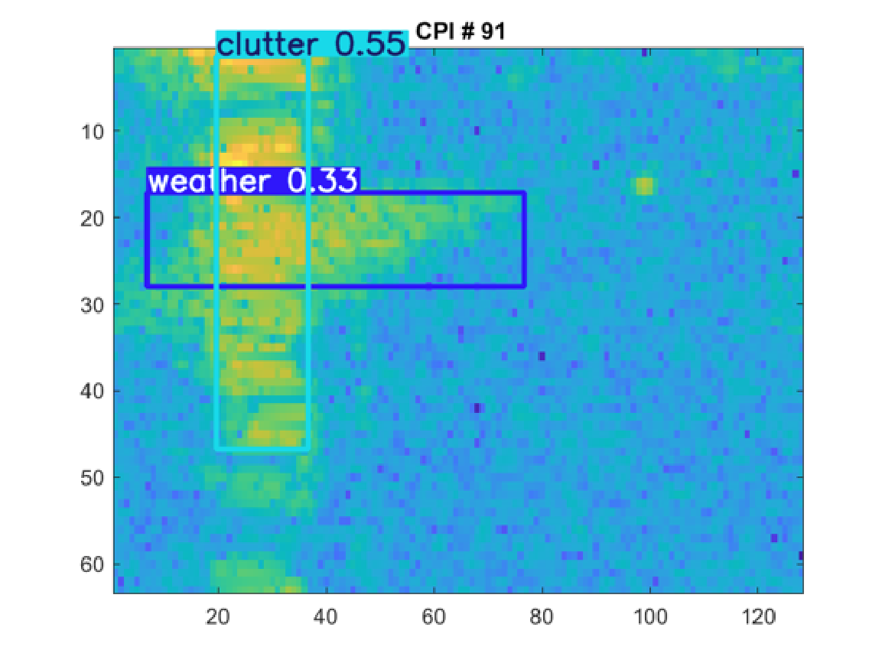
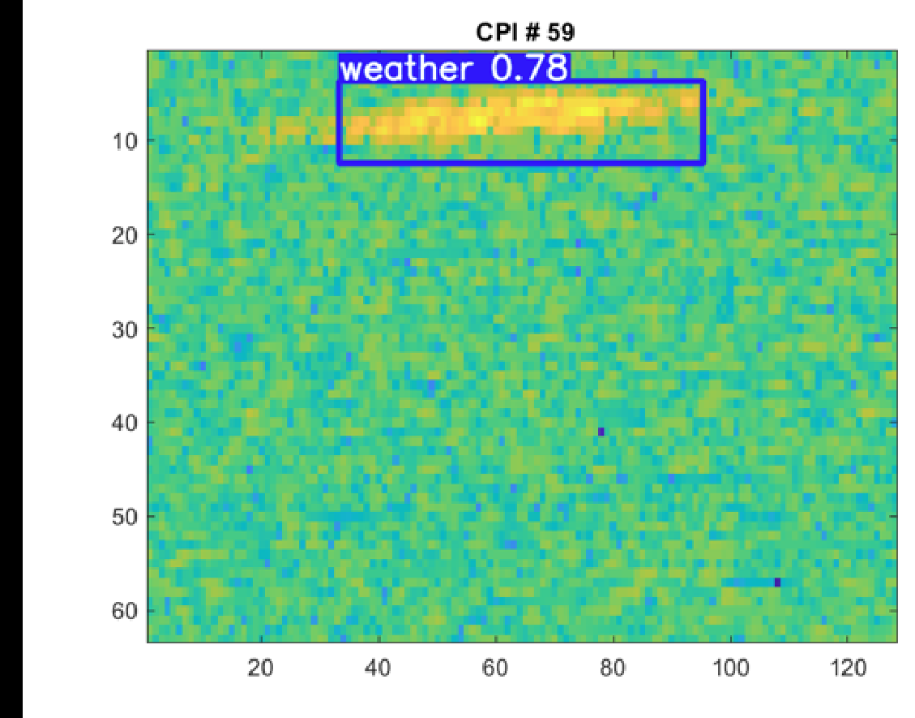
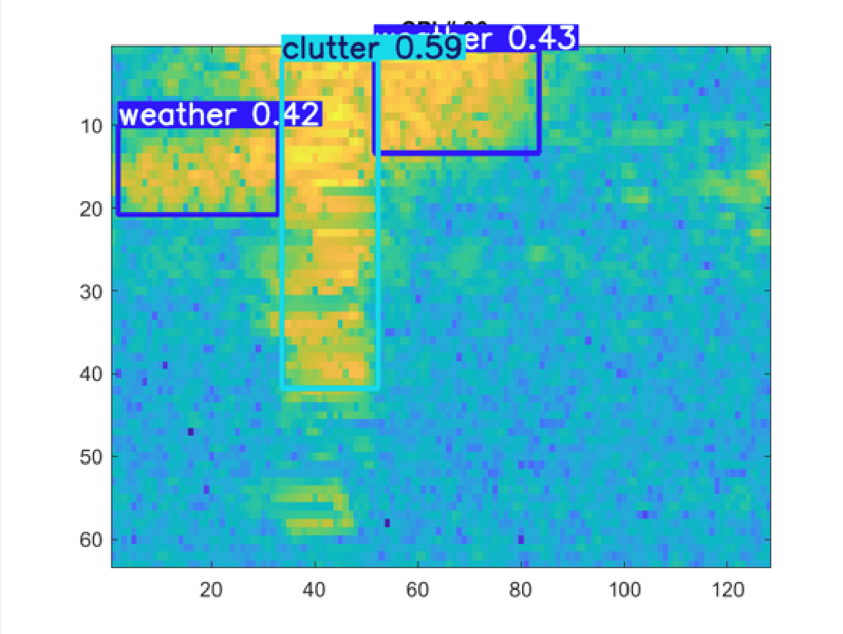
Results (1 / 2)

Slide 11
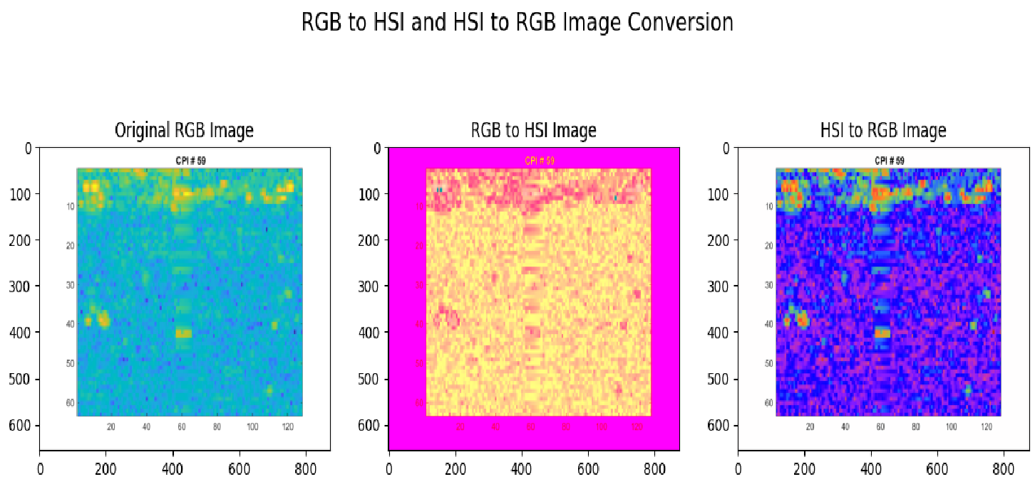
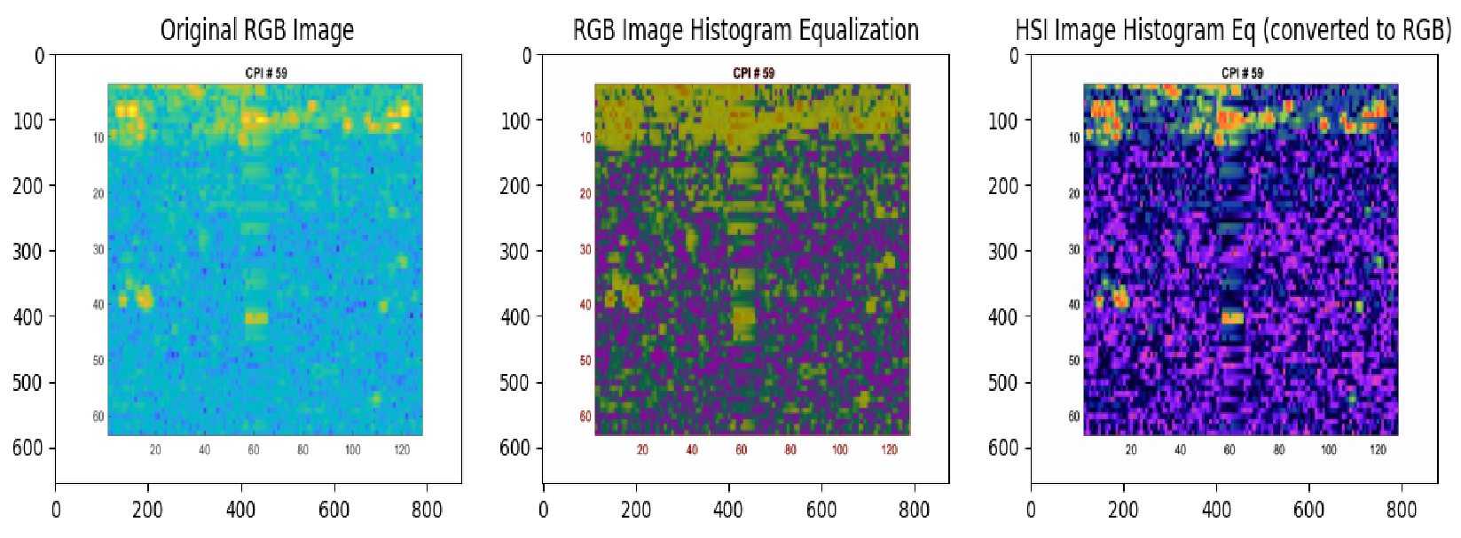
Results (2 / 2)

Slide 12
Learning:
The HSI color space is believed to offer improved classification over RGB color space as hue component remains consistent under varying light conditions and edges are are more intense .
Large and well annotated training data converges the model to optimum level (Law of large numbers).
SGD best for real time object detection as it requires no memory .
Optimizing hyperparamaters depends upon ur day.(learning rate ,batch size ,epochs )

Slide 13
Individual Contributions :
Abhilash S | Literature Survey + Presentation+ Paper Drafting + Geometric Approach of RGB to HSI conversion ( HUE , Saturation, Intensity)
Pankaj | Presentation drafting + Yolov5 code implementation.
Adil | Research on RGB to Hyperspectral Imaging conversion +Modelling of RGB to Hyperspectral architecture.
Harshvardhan | Literature Survey + Problem Statement Analysis+ Object Detection implementation + Low SNR Data set modelling.

Slide 14
Thank You

Slide 18
BackUp
The HSI color space is believed to be less sensitive to illumination changes compared to the RGB color space. This is because the Hue and Saturation components are more robust to changes in lighting conditions, while the Intensity component captures the brightness information. As a result, HSI-based algorithms are expected to provide better results in tasks like color segmentation and object detection, as they can better compensate for varying illumination levels. This makes the HSI color space more suitable for applications like road sign detection, where the goal is to identify objects under different lighting conditions.

Slide 19
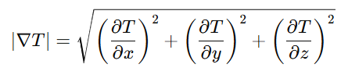

1
Three-Dimensional Temperature Gradient
Assumptions :
Converting from RGB to HSI involves nonlinear calculations, including trigonometric operations for Hue and conditional logic for Saturation, which requires complex hardwares. We took assumption on our dataset as HSI images were not available, so we converted our RGB images to HSI using Geometrical Approach and approximated to our best conversion .
C:\Users\H479927\OneDrive - Honeywell\pattern recognition books and notes\DeepLearning_EE6380\CAT Paper\RGB_to_HSI.pdf

Slide 20
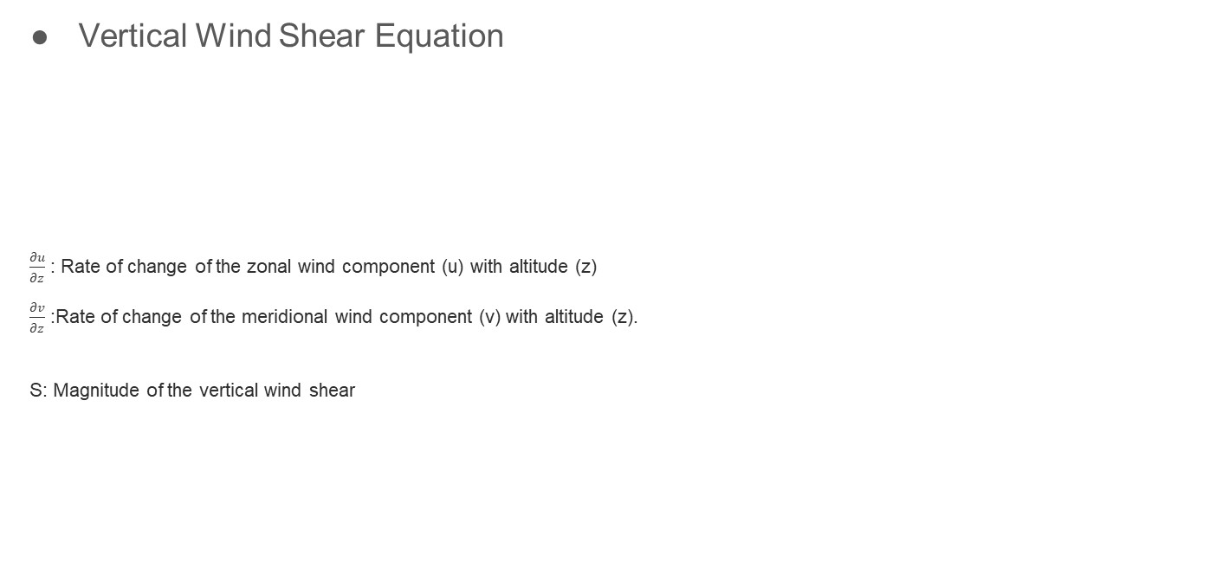
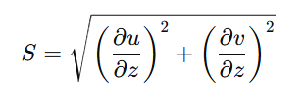

Slide 21
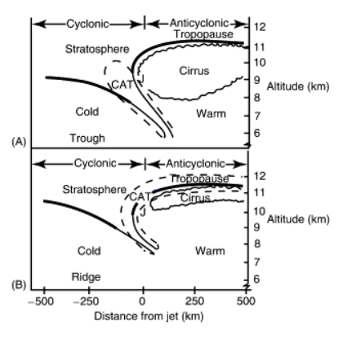
The diagram illustrates:
The vertical and horizontal structure of the polar jet stream in different configurations (troughs and ridges).
The typical regions where CAT is most likely to form, based on:
Wind shear (both vertical and horizontal): Rapid changes in wind speed and direction between layers.
Instabilities created by the interaction of the jet stream with the surrounding atmosphere (e.g., temperature gradients, frontal zones)

Slide 22
Motivation
CAT has been linked to numerous aircraft accidents, highlighting the urgent need to improve detection and classification methods. Enhancing safety in aviation is a primary motivation, as better understanding and predicting CAT can help prevent accidents and protect lives.
Traditional radar systems often fail to detect CAT due to its unpredictable nature and the limitations of existing technologies. This research aims to address these challenges by developing more effective methods for identifying CAT, thereby improving overall radar performance.
CAT not only poses direct risks to aircraft but also interferes with radar echoes, which can degrade the quality of weather radar data. By improving the detection of CAT, the research seeks to enhance the reliability of weather radar systems, leading to better-informed flight operations.
The unpredictable nature of CAT often leaves pilots unaware of potential hazards. By advancing detection techniques, the research aims to provide pilots with critical information that can help them navigate safely through turbulent conditions.
The introduction of a neural network approach represents a significant advancement in the field of radar target classification. This motivation is driven by the desire to leverage modern machine learning techniques to solve complex problems in aviation safety.
Safety Concerns
Detection Challenges
Impact on Radar Data Quality
Pilot Awareness
Technological Advancement

Slide 23
Learnings (1 or 2 slides)
Summarize your learnings from the project - specifically, what you learned that complemented the classroom learning. These could be one of more of the following:
Classical problems
Technical tools
Implementation details
Soft skills
Any other points you would like to highlight

